Slide 1
Tamil-to-English Translation, Summarization, and Image Generation App
Leveraging NLP and Generative Models

Slide 2
INTRODUCTION
To develop a web-based application that first translates text from Tamil to English and then uses the translated text to generate relevant images.
This application aims to demonstrate the seamless integration of language translation and creative AI to produce visual content from textual descriptions.

Slide 3
TECHNOLOGIES USED
Models:
- Translation: Helsinki-NLP/opus-mt-mul-en
- Summarization: facebook/bart-large-cnn
- Image Generation: black-forest-labs/FLUX.1-dev
Framework: Gradio for the UI.
Libraries: Hugging Face Transformers, Diffusers, Torch.

Slide 4
ARCHITECTURE
The application consists of three main components:
Translation Module: Handles the translation of input Tamil text to English.
Summarization Module: Generates a summary of the translated text.
Image Generation Module: Produces an image based on the summarized text.

Slide 5
USER INTERACTION
Input: Users can input Tamil text in a designated textbox.
Processing: Upon clicking the "Generate" button, the application processes the input through translation, summarization, and image generation steps.
Output: The translated text, summarized text, and generated image are displayed to the user.

Slide 6
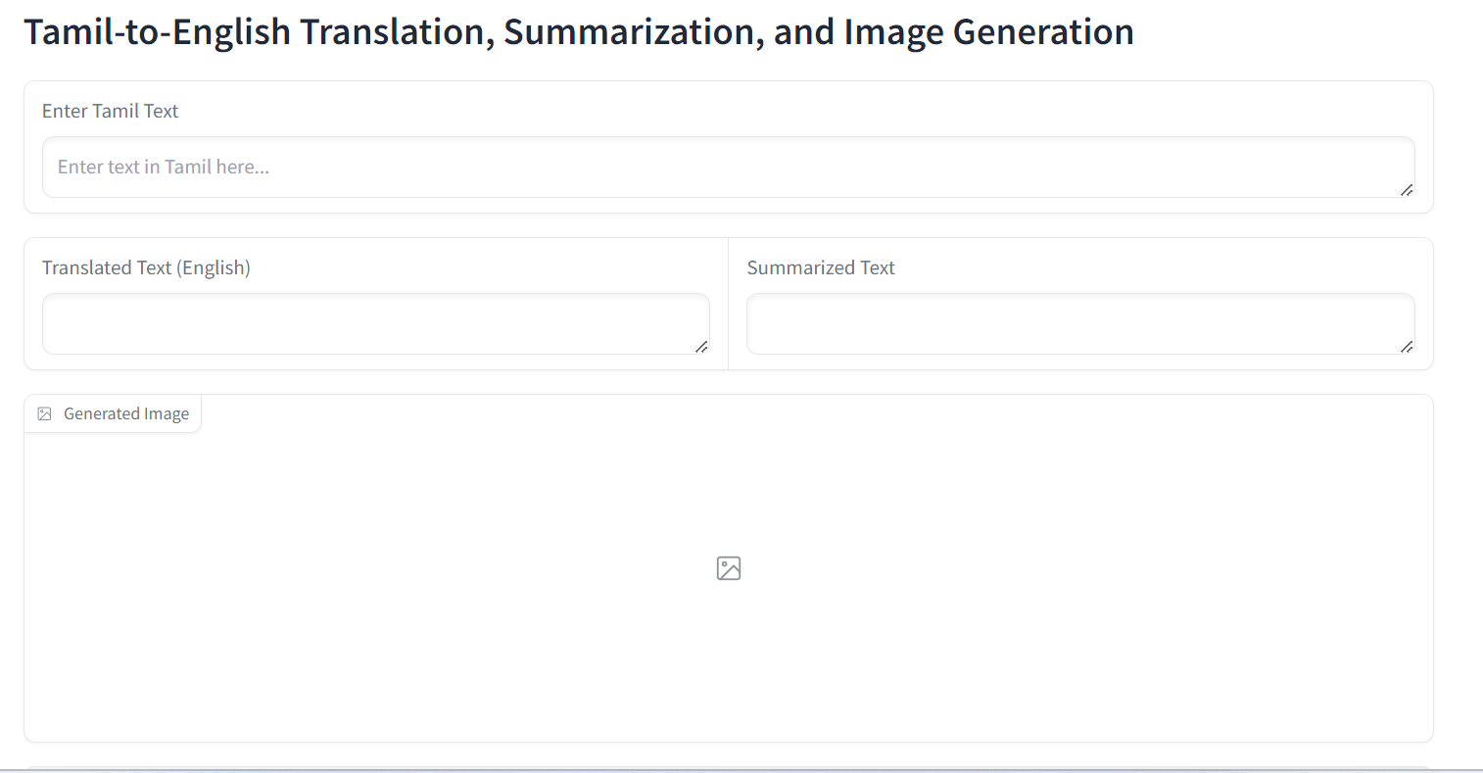
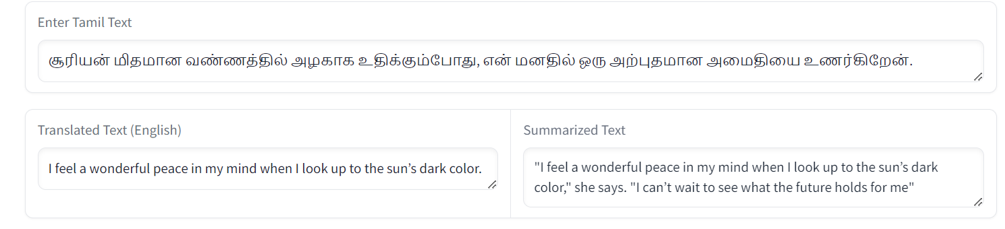


Slide 7
CODE OVERVIEW – PURPOSE OF CODE
The code is designed to implement a multimodal AI application that translates Tamil text to English, summarizes the translated text, and generates images based on the summaries.
It utilizes state-of-the-art models from Hugging Face for translation, summarization, and image generation, ensuring high accuracy and performance.

Slide 8
CODE OVERVIEW – KEY COMPONENTS OF CODE
Imports and Dependencies:
The code imports necessary libraries such as GRADIO for the user interface, REQUESTS for API calls, and OS for environment variable management.
It also includes Hugging Face libraries for loading models and making predictions.
API Configuration:
Hugging Face API Key: The API key is stored as an environment variable for secure access to Hugging Face models.
Model URLs: The code defines the URLs for each model:
Translation: Helsinki-NLP/opus-mt-mul-en
Summarization: facebook/bart-large-cnn
Image Generation: CompVis/stable-diffusion-v1-4…….CONTINUE

Slide 9
CODE OVERVIEW – KEY COMPONENTS OF CODE
Functions:
query_hf_api(model_url, payload):
A helper function that sends requests to the Hugging Face Inference API and retrieves model outputs.
translate_to_english(text):
This function takes Tamil text as input, calls the translation model via the API, and returns the translated English text.
summarize_text(translated_text):
It receives translated text, invokes the summarization model, and returns the summary.
generate_image_from_text(summary_text):
Generates an image based on the summary text and saves it to a file.
process_text(tamil_text):
This is the main processing function that orchestrates translation, summarization, and image generation, returning the outputs to be displayed in the UI.

Slide 10
FUTURE WORK
Enhancements:
Potential improvements could include adding support for additional languages, optimizing model performance, and enhancing the user interface design.
Feedback Loop:
Incorporate user feedback mechanisms to refine the application based on user experiences and requirements.

Slide 11
CONCLUSION
The code is modular and organized, allowing easy updates and maintenance.
It effectively integrates multiple AI capabilities into a single application, enhancing user experience by providing translation, summarization, and visual representation of the content.

Slide 12


